Slide 1
(Chapter 3)
Advanced Java Programming
Notes:
Riddhi Patel (Lecturer at LDRP-ITR)

Slide 2
Network. Host. Internet
A network is a hardware and software data communication system that provides interconnection of computers and other devices.
A node (host) is an addressable device (computer) attached to a computer network.
An internet is a set of networks connected with routers.
The Internet is the largest internet that includes commercial, military, university and other networks with different physical links and various protocols including IP (Internet Protocol)

Slide 3
Networking Terminologies
The widely used Java networking terminologies used are as follows:
IP Address
Protocol
Port Number
MAC Address
Connection-oriented and connection-less protocol
Socket

Slide 4
Conti
1. IP Address
The IP address is a unique number assigned to a node of a network e.g. 192.168.0.1. It is composed of octets that range from 0 to 255.
2. Protocol
A protocol is a set of rules followed for communication. For example:
TCP
FTP
Telnet
SMTP
POP etc.

Slide 5
Conti
3. Port Number
The port number uniquely identifies different applications. It acts as a communication endpoint between applications. To communicate between two applications, the port number is used along with an IP Address.
4. MAC Address
A MAC address is basically a hardware identification number which uniquely identifies each device on a network. For example, an Ethernet card may have a MAC address of 00:0d:83:b1:c0:8e.
5. Connection-oriented and connection-less protocol
In the connection-oriented protocol, acknowledgment is sent by the receiver. So it is reliable but slow. The example of a connection-oriented protocol is TCP. But, in the connection-less protocol, acknowledgment is not sent by the receiver. So it is not reliable but fast. The example of a connection-less protocol is UDP.

Slide 6
Conti
6. Socket
A socket in Java is one endpoint of a two-way communication link between two programs running on the network. A socket is bound to a port number so that the TCP layer can identify the application that data is destined to be sent to.
Now that you know various terminologies used in Java Networking, let’s move further and understand some of the important classes that it supports.
Inet Address
Inet Address is used to encapsulate both the numerical IP address and the domain name for that address. It can handle both IPv4 and Ipv6 addresses. Below figure depicts the subclasses of Inet Address class.

Slide 7





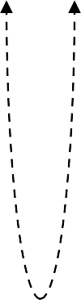






Multi-Layered Network Architecture
The seven-layer OSI (Open System Interconnect) model
The IP networking stack includes 5 layers
Application (FTP, HTTP)
Transport (TCP, UDP)
Network (IP)
Datalink (Ethernet frames)
Application (FTP, HTTP)
Transport (TCP, UDP)
Network (IP)
Datalink (Ethernet frames)
Physical (e.g. Ethernet, FDDI)

Slide 8
Java Networking is a notion of connecting two or more computing devices together to share the resources.
Java program communicates over the network at the application layer. java.net package is useful for all the Java networking classes and interfaces.
The java.net package provides support for two protocols. They are as follows:
TCP − Transmission Control Protocol allows reliable communication between two applications. TCP is typically used over the Internet Protocol, which is referred to as TCP/IP.
UDP − User Datagram Protocol is a connection-less protocol that allows packets of data to be transmitted between applications.

Slide 9


Two essential types of sockets
STREAM
  a.k.a. TCP
  reliable delivery
  in-order guaranteed
  connection-oriented
  bidirectional
Limit on Number of Processes that can successfully request service at a time
“Listen” for service requests
Service Request
2
1
Service Request
Request Serviced
Process
Service Request
3
Connect

Slide 10


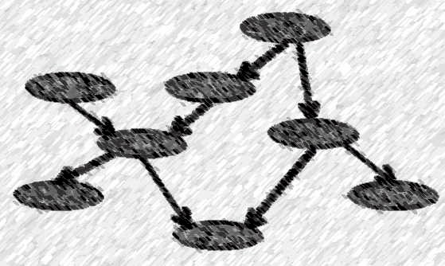
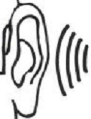
Two essential types of sockets
DATAGRAM
  a.k.a. UDP
  unreliable delivery; data can be lost, although this is unusual
  no order guarantees
  no notion of “connection” – app indicates dest. for each packet
  can send or receive
Process
Send to recipient
Indeterminate path
Process
Receive from Sender

Slide 11
1. Transport Protocols: TCP
TCP, Transmission Control Protocol, is a reliable connection-oriented stream-based transport protocol.
  Allows sending data in a continuous stream.
  Guarantees delivering in proper order.
Phases of TCP communication:
  Establish a connection (open a TCP session)
  Transfer data over the connection
  Release the connection
Applications using TCP: file transfer, email, WWW
TCP is used on Ethernet and the Internet: TCP/IP
  See: the standard STD 7, and the Request For Comments RFC 793
    Standards and RFCs

Slide 12
2. Transport Protocols: UDP
UDP, the User Datagram Protocol
  For pure message passing (datagram send/receive).
  Neither guarantees delivery nor requires a connection.
  Connectionless:
    UDP datagrams are sent between two hosts with no previous setup.
    The datagrams contain the destination address, may take different routes.
  Lightweight and efficient. Low overhead compare to TCP
Phases of UDP communication:
  Sending: create a UDP socket; create a datagram with the message and specified destination (IP address & port); send the datagram over the UDP socket.
  Receiving: receive a datagram from the UDP socket; get data and source from the datagram
Applications using UDP: DNS, streaming media (IPTV, VoIP, video- conferencing), online games
UDP is layered on top of IP: UDP/IP; See STD 6, RFC 768

Slide 13
Network Protocol: IP
IP, Internet Protocol, is a network layer protocol used for routing.
  IP is connectionless
    IP datagrams fragmented into IP packets
    IP header includes destination, source, and time-to-live (TTL)
  See STD 5, RFC 791

Slide 14
Addressing a Node on the Internet.
IP Address
An Internet address (IP address) of a node on the Internet is a four-byte (32-bit) unsigned integer number (IPv4).
  Dot decimal notation: four unsigned integers, each ranging from 0 to 255, separated by periods.
– Example: 130.237.214.84
  127.0.0.1 - the local loopback interface, localhost
  Addresses beginning with 0.0 refer to hosts on the same LAN.
    0.0.0.0 is used as a source address of the originating host.
  Addresses beginning with 10. and 192.168. are non-routable and can be used on internal (private) networks.
  Addresses beginning with 224. are multicast addresses.
    224.0.0.1 - multicast address on the LAN

Slide 15









IP Address Classes
Internet addresses are assigned by Internet Corporation for Assigned Names and Numbers (ICANN) through Internet Service Providers (ISPs)
Internet address classes
  A (1-126.x.x.x) – 126 address blocks, each of 16,000,000 addresses.
  B (128-191.x.x.x) – one address block contains ~65,000 addresses.
  C (192-223.x.x.x) – one address block contains 254 addresses.
  D (224-239.x.x.x) – multicast addresses.
– E (240-255.x.x.x) –reserved.
Classes
Byte 0 Byte 1 Byte 2 Byte 3
A B C D E
0
Network
Host
1 0
Network Host
1 1 0
Network
Host
1 1 1 0
Multicast Group
1 1 1 1 0

Slide 16
Addressing a Node on Ethernet.
MAC Address
MAC (Media Access Control) address
  The HW address of a device connected to a shared network medium, e.g. Ethernet.
  MAC address is used by the link layer.
ARP (Address Resolution Protocol) is used for conversion of an IP address into the corresponding MAC address.
  The sender broadcasts an ARP packet with the Internet destination address and waits for the destination host to send back its Ethernet address.
    If no reply, the “unreachable host” ICMP message is generated
  Each host maintains a cache of address translations.
arp -­‐a
  Display the Internet-to-Ethernet address translation tables.

Slide 17
Host Names
A hostname is a unique name of a computer on the Internet. It consists of a local name and a domain name.
– For example: oyster.it.kth.se
A machine may have multiple names, for example:
  mail.it.kth.se - an e-mail server
  ftp.it.kth.se - an FTP server
  piraya.it.kth.se - a host on the Internet.
One name can be mapped to multiple IP addresses
– Web site with multiple hosts
See http://www.iana.org/domain-names.htm

Slide 18
DNS: Domain Name System
DNS is a distributed service on the Internet that translates host names into IP addresses.
Search for a host information:
  Lookup in the local cache: the /etc/hosts file
  optional: NIS (Network Information Service)
  Lookup in DNS

Slide 19
Ports
Port is an entry point to a process that resides on a host.
65,535 logical ports with integer numbers 1 - 65,535
A port can be allocated to a particular service:
  A server listens the port for incoming requests
  A client connects to the port and requests the service
  The server replies via the port.
Ports with numbers 1-1023 are reserved for well-known services.

Slide 20
Some Assigned Ports (RFC 1060)
echo | 7 | tcp/udp | Echo back the input
discard | 9 | tcp/udp | Discard the input
daytime | 13 | tcp/udp | Output an ASCII string with the current time
ftp-data | 20 | tcp | Data port of ftp: transfer file
ftp | 21 | tcp | Command port of ftp: send ftp command
telnet | 23 | tcp | Interactive remote command-line sessions
smtp | 25 | tcp | “Simple Mail Transfer Protocol”: send email
time | 37 | tcp/udp | The number of seconds since Jan. 1, 1990
whois | 43 | tcp | Directory service for Internet administrators
finger | 79 | tcp | Information about a user or users
http | 80 | tcp | HyperText Transfer Protocol of WWW
pop3 | 110 | tcp | Post Office Protocol for server-to-client mail
nntp | 119 | tcp | Network News Transfer Protocol
RMI | 1019 | tcp | Java RMI registry service

Slide 21
Sockets
Socket is an end-point of a virtual network connection between processes – much like a full-duplex channel
  A socket address: IP address and a port number
  A socket type: distinguished by the transport protocol used for communication over the socket
    TCP socket - stream-based, connection-oriented
    UDP socket - datagram-based, connectionless
The socket API in C, a.k.a. Berkeley sockets, was introduced in 1981 as the Unix BSD 4.2 generic API for inter-process communication
Initially was a part of the kernel (BSD Unix)
Today is a library (Solaris, MS-DOS, Windows, OS/2, MacOS)

Slide 22
What is a socket?
An interface between application and network
  The application creates a socket
  The socket type dictates the style of communication
    reliable vs. best effort
    connection-oriented vs. connectionless
Once configured, the application can
  pass data to the socket for network transmission
  receive data from the socket (transmitted through the network by some other host)

Slide 23
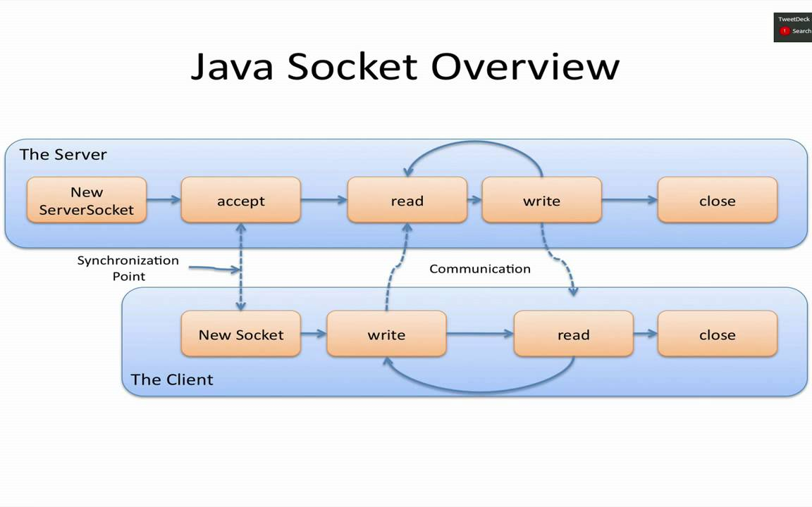
Overview

Slide 24


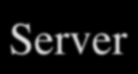
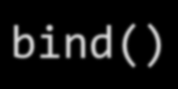


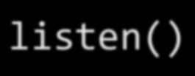


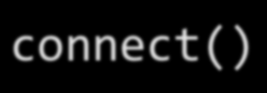
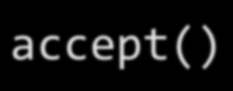

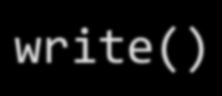


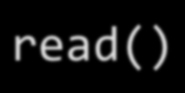
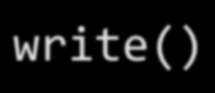
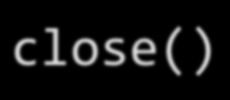
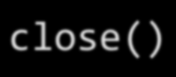
Socket API for the Client- Server Architecture
Client
socket()
Server
bind()
socket()
Connection
listen()
is established
Start a thread
connect()
accept()
accept()
write()
0.1/
PTTH lmth.x
edni/ TEG
read()
read()
HTTP/1.0 200 OK … </html>
write()
close()
close()

Slide 25
Example 1 : Client Programming
Create stream socket (socket() )
Create Input,Output streams and attach to socket
While still connected:
  Write(read) data to(from) input(output) stream
Close TCP connection and Socket (close())

Slide 26
public class SimpleClient {
public static void main(String args[]) throws IOException {
Socket s;
DataOutputStream dos;
s = new Socket("localhost",6434);
dos = new DataOutputStream(s.getOutputStream());
dos.writeUTF(“Hello Dr.Han");
dos.close();
s.close();
}
}

Slide 27
example 2 : Server Programming
Create server socket (ServerSocket() )
Bind port to socket
Listen for new client
While
  accept user connection and create a new socket (accept() )
  Create Input,Output streams and attach to socket
  Write(read) data to(from) input(output) stream
Close TCP connection and Socket (close())

Slide 28
public class SimpleServer {
public static void main(String args[]) {
ServerSocket s = null;
Socket schild;
DataInputStream dis;
s = new ServerSocket(6434);
while(true) {
schild = s.accept();
dis = new DataInputStream(schild.getInputStream());
String str = new String (dis.readUTF());
System.out.println(str);
dis.close();
schild.close();
}
s.close();
}
}

Slide 29
Objectives
The InetAddress Class
Using sockets
  TCP sockets
  Datagram Sockets

Slide 30
Classes in java.net
The core package java.net contains a number of classes that allow programmers to carry out network programming
  ContentHandler
  DatagramPacket
  DatagramSocket
  DatagramSocketImplHttpURLConnection
  InetAddress
  MulticastSocket
  ServerSocket
  Socket
  SocketImpl
  URL
  URLConnection
  URLEncoder
  URLStreamHandler

Slide 31
Exceptions in Java
BindException
ConnectException
MalformedURLException
NoRouteToHostException
ProtocolException
SocketException
UnknownHostException
UnknownServiceException

Slide 32
The InetAddress Class
Handles Internet addresses both as host names and as IP addresses
Static Method getByName returns the IP address of a specified host name as an InetAddress object
Methods for address/name conversion:
  public static InetAddress getByName(String host) throws UnknownHostException
  public static InetAddress[] getAllByName(String host) throws UnknownHostException
  public static InetAddress getLocalHost() throws UnknownHostException
  public boolean isMulticastAddress()
  public String getHostName()
  public byte[] getAddress()
  public String getHostAddress()
  public int hashCode()
  public boolean equals(Object obj)
  public String toString()

Slide 33
The Java.net.Socket Class
Connection is accomplished via construction.
  Each Socket object is associated with exactly one remote host.
    To connect to a different host, you must create a new Socket object.
    public Socket(String host, int port) throws UnknownHostException, IOException
    connect to specified host/port
    public Socket(InetAddress address, int port) throws IOException
    connect to specied IP address/port
    public Socket(String host, int port, InetAddress localAddress, int localPort) throws IOException
    connect to specified host/port and bind to specified local address/port
    public Socket(InetAddress address, int port, InetAddress localAddress, int localPort) throws IOException
    connect to specified IP address/port and bind to specified local address/port
Sending and receiving data is accomplished with output and input streams. There are methods to get an input stream for a socket and an output stream for the socket.
    public InputStream getInputStream() throws IOException
    public OutputStream getOutputStream() throws IOException
To close a socket:
    public void close() throws IOException

Slide 34
The Java.net.ServerSocket Class
The java.net.ServerSocket class represents a server socket. It is constructed on a particular port. Then it calls accept() to listen for incoming connections.
  accept() blocks until a connection is detected.
  Then accept() returns a java.net.Socket object that is used to perform the actual communication with the client.
    the “plug”
  backlog is the maximum size of the queue of connection requests
  public ServerSocket(int port) throws IOException
  public ServerSocket(int port, int backlog) throws IOException
  public ServerSocket(int port, int backlog, InetAddress bindAddr) throws IOException
  public Socket accept() throws IOException
  public void close() throws IOException

Slide 35
Socket programming with UDP
UDP: no “connection” between client and server
no handshaking
sender explicitly attaches IP address and port of destination to each packet
UDP: transmitted data may be received out of order, or lost

Slide 36
Class Datagramsocket
DatagramSocket(int port)
Create DatagramSocket object with port number
Methods
public void receive(DatagramPacket p) throws IOException
public void send(DatagramPacket p) throws IOException
public void close() throws IOException

Slide 37
Class Summary
public class java.net.DatagramSocket extends java.lang.Object {
// Constructors
public DatagramSocket();
public DatagramSocket(int port);
public DatagramSocket(int port, InetAddress laddr);
Instance Methods public void close();
public InetAddress getLocalAddress();
public int getLocalPort();
public synchronized int getSoTimeout();
public synchronized void receive(DatagramPacket p);
public void send(DatagramPacket p);
public synchronized void setSoTimeout(int timeout);
}

Slide 38
Client/server socket interaction: UDP
Server (running on hostid)
Client
create socket,
Port=6434, for
incoming request:
create socket,
clientSocket =
DatagramSocket()
serverSocket =
DatagramSocket()
Create, address (hostid, port=6434,
send datagram request
using clientSocket
read request from
serverSocket
write reply to
serverSocket
specifying client
host address,
port number
read reply from
clientSocket
close
clientSocket

Slide 39
Example: Java client (UDP)
import java.io.*;
import java.net.*;
class UDPClient {
public static void main(String args[]) throws Exception
{
BufferedReader inFromUser =
new BufferedReader(new InputStreamReader(System.in));
DatagramSocket clientSocket = new DatagramSocket();
InetAddress IPAddress = InetAddress.getByName("hostname");
byte[] sendData = new byte[1024];
byte[] receiveData = new byte[1024];
String sentence = inFromUser.readLine();
sendData = sentence.getBytes();
Create
input stream
Create
client socket
Translate
hostname to IP
address using DNS

Slide 40
Example: Java client (UDP), cont.
Create datagram with data-to-send,
length, IP addr, port
DatagramPacket sendPacket =
new DatagramPacket(sendData, sendData.length, IPAddress, 9876);
clientSocket.send(sendPacket);
DatagramPacket receivePacket =
new DatagramPacket(receiveData, receiveData.length);
clientSocket.receive(receivePacket);
String modifiedSentence =
new String(receivePacket.getData());
System.out.println("FROM SERVER:" + modifiedSentence);
clientSocket.close();
}
}
Send datagram
to server
Read datagram
from server

Slide 41
Example: Java server (UDP)
import java.io.*;
import java.net.*;
class UDPServer {
public static void main(String args[]) throws Exception
{
DatagramSocket serverSocket = new DatagramSocket(9876);
byte[] receiveData = new byte[1024];
byte[] sendData = new byte[1024];
while(true)
{
DatagramPacket receivePacket =
new DatagramPacket(receiveData, receiveData.length);
serverSocket.receive(receivePacket);
Create
datagram socket
at port 9876
Create space for
received datagram
Receive
datagram

Slide 42
Example: Java server (UDP), cont
String sentence = new String(receivePacket.getData());
InetAddress IPAddress = receivePacket.getAddress();
int port = receivePacket.getPort();
String capitalizedSentence = sentence.toUpperCase();
sendData = capitalizedSentence.getBytes();
DatagramPacket sendPacket =
new DatagramPacket(sendData, sendData.length, IPAddress,
port);
serverSocket.send(sendPacket);
}
}
}
Get IP addr
port #, of
sender
Create datagram
to send to client
Write out
datagram
to socket
End of while loop,
loop back and wait for
another datagram

Slide 43

Socket-programming using TCP
TCP service: reliable transfer of bytes from one process to another
controlled by
application
developer
controlled by
application
developer
process
process
socket
socket
TCP with
buffers,
variables
TCP with
buffers,
variables
controlled by
operating
system
controlled by
operating
system
internet
host or
server
host or
server

Slide 44
Socket programming with TCP
Client must contact server
server process must first be running
server must have created socket (door) that welcomes client’s contact
Client contacts server by:
creating client-local TCP socket
specifying IP address, port number of server process
When client creates socket: client TCP establishes connection to server TCP
When contacted by client, server TCP creates new socket for server process to communicate with client
  allows server to talk with multiple clients
  source port numbers used to distinguish clients

Slide 45
Class serversocket
ServerSocket(int port)
public ServerSocket(int port) throws IOException
Methods
public InetAddress getInetAddress()
public int getLocalPort()
public Socket accept() throws IOException
public void close() throws IOException

Slide 46
Method Summary
void close()
Closes this socket.
InetAddress getInetAddress()
Returns the address to which the socket is connected.
InputStream getInputStream()
Returns an input stream for this socket.
InetAddress getLocalAddress()
Gets the local address to which the socket is bound.
int getLocalPort()
Returns the local port to which this socket is bound.
OutputStream getOutputStream()
Returns an output stream for this socket.
int getPort()
Returns the remote port to which this socket is connected.

Slide 47
Conti
int getReceiveBufferSize()
Get value of the SO_RCVBUF option for this socket, that is the buffer
size used by the platform for input on the this Socket.
int getSendBufferSize()
Get value of the SO_SNDBUF option for this socket, that is the buffer size used by the platform for output on the this Socket.
int getSoLinger()
Returns setting for SO_LINGER. -1 returns implies that the option is disabled.
int getSoTimeout()
Returns setting for SO_TIMEOUT. 0 returns implies that the option is disabled (i.e.

Slide 48
Client/server socket interaction: TCP
Server (running on hostid)
Client
create socket,
port=6434, for
incoming request:
welcomeSocket =
ServerSocket()
TCP
connection setup
create socket,
connect to hostid, port=6434
wait for incoming
connection request
connectionSocket =
welcomeSocket.accept()
clientSocket =
Socket()
send request using
clientSocket
read request from
connectionSocket
write reply to
connectionSocket
read reply from
clientSocket
close
connectionSocket
close
clientSocket

Slide 49
Server: Alternative Ways of Handling Many Clients
Forking a new process for each client:
But, creating new process is expensive.
Multithreaded implementation: have one thread handling each client.
Thread is like a process but light-weighted.

Slide 50
Socket programming with TCP
Example client-server app:
1) client reads line from standard input (inFromUser stream) , sends to server via socket (outToServer stream)
2) server reads line from socket
3) server converts line to uppercase, sends back to client
4) client reads, prints modified line from socket (inFromServer stream)

Slide 51
Example: Java client (TCP)
import java.io.*;
import java.net.*;
class TCPClient {
public static void main(String argv[]) throws Exception
{
String sentence;
String modifiedSentence;
BufferedReader inFromUser =
new BufferedReader(new InputStreamReader(System.in));
Socket clientSocket = new Socket("hostname", 6789);
DataOutputStream outToServer =
new DataOutputStream(clientSocket.getOutputStream());
Create
input stream
Create
client socket,
connect to server
Create
output stream
attached to socket

Slide 52
Example: Java client (TCP), cont.
Create
input stream
attached to socket
BufferedReader inFromServer =
new BufferedReader(new
InputStreamReader(clientSocket.getInputStream()));
sentence = inFromUser.readLine();
outToServer.writeBytes(sentence + '\n');
modifiedSentence = inFromServer.readLine();
System.out.println("FROM SERVER: " + modifiedSentence);
clientSocket.close();
}
}
Send line
to server
Read line
from server

Slide 53
Example: Java server (TCP)
import java.io.*;
import java.net.*;
class TCPServer {
public static void main(String argv[]) throws Exception
{
String clientSentence;
String capitalizedSentence;
ServerSocket welcomeSocket = new ServerSocket(6789);
while(true) {
Socket connectionSocket = welcomeSocket.accept();
BufferedReader inFromClient =
new BufferedReader(new
InputStreamReader(connectionSocket.getInputStream()));
Create
welcoming socket
at port 6789
Wait, on welcoming
socket for contact
by client
Create input
stream, attached
to socket

Slide 54
Example: Java server (TCP), cont
Create output
stream, attached
to socket
DataOutputStream outToClient =
new DataOutputStream(connectionSocket.getOutputStream());
clientSentence = inFromClient.readLine();
capitalizedSentence = clientSentence.toUpperCase() + '\n';
outToClient.writeBytes(capitalizedSentence);
}
}
}
Read in line
from socket
Write out line
to socket
End of while loop,
loop back and wait for
another client connection

Slide 55
Outlines
Multiply two numbers
Client : Enter the number
Server : multiply the number entered by client.
Create chat with different methods
Client : start to chat with server

